Slide 1
Web Design
Concept of Web Design
Structure of Web Site
Publish Wes Site
Concept of HTML
HTML Formatting
HTML Font, Color, List
HTML Image, Audio, Video
HTML Hyperlink
HTML Table
HTML Form

Slide 2
What is WWW
The World Wide Web, commonly known as the Web, is an information system enabling documents and other web resources to be accessed over the Internet. Documents and downloadable media are made available to the network through web servers and can be accessed by programs such as web browsers. It was invented by Tim Berners-Lee at CERN in 1989 and opened to the public in 1991
There are three main components of WWW
HTML – Hyper Text Markup Language
HTTP – Hyper Text Transfer Protocol
Web Browser
What is Web Browsing
Visiting from one page to another page is refer to web browsing
What is Web Browser
The software used for web browsing or displaying web pages is called web browser
Example: Internet Explorer, Google Chrome, Mozilla Firefox, Opera, UC, Safari etc.

Slide 3
What is Web Page
The individual pages of a web site are called Web Page, we also say that this web page also created by the using of HTML.
We can display various types of information on web pages like : audio, video, images, text etc.
What is Website
A website is an address on the Internet that contains one or more related web pages
Example : www.google.com
What is home page / index page
The entrance to the website is called the home page or index page.
When we enter a website, the first page we see is called the home page

Slide 4
What is Web Design
Web design is to determine how the pages of the website will be displayed to the user in the web browser
What type of font, color will be use ?
Where the web page will be kept ?
Advantages of web site
We can know the information regarding college of university
We can know the result of the exam
We can collect bus, train, plane tickets
We can make friends using social media
We can share video through video sharing website
We can take classes at home

Slide 5

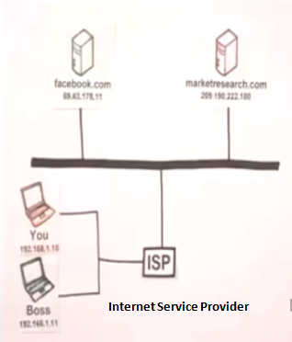
What is IP address
IP Address = Internet Protocol Address
Every computer connected to the Internet has an address called an IP address
This IP address cannot be used on more than one device
This IP address distributes by ICANN (Internet Corporation for Assigned Names and Numbers)

Slide 6
Domain Name
The IP address is very difficult to remember so a name is used instead called a domain name. Example: www.facebook.com, www.youtube.com
The system in which domain names are controlled is called DNS (Domain Name System)

Slide 7
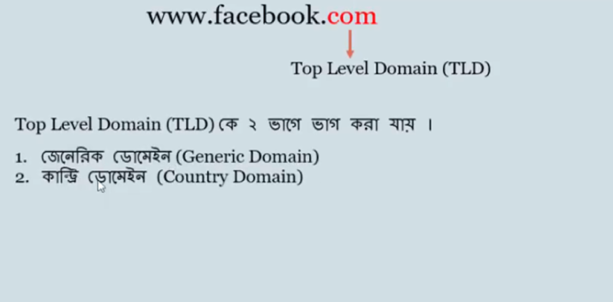

Slide 8
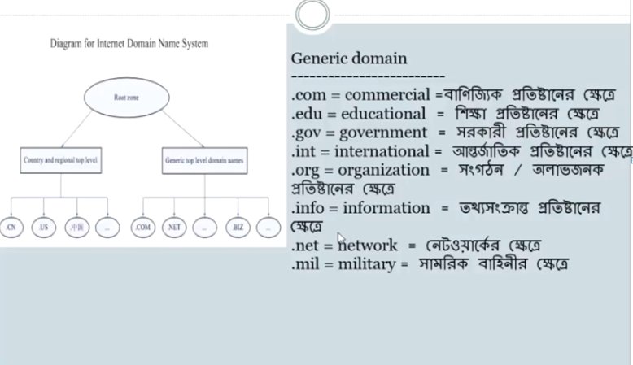

Slide 9
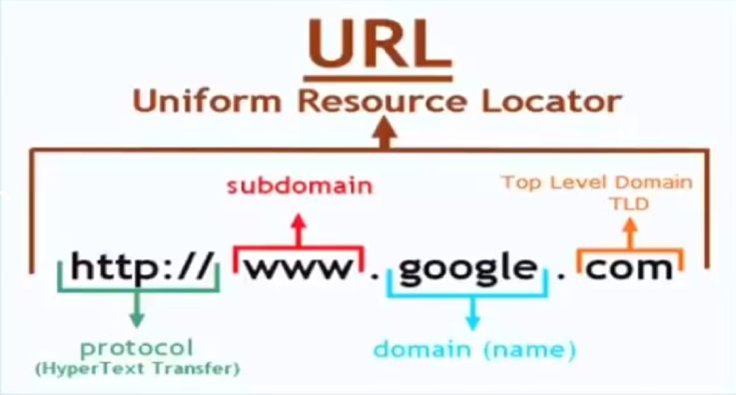

A web page address is called a URL
Domain names are expressed by URLs
There are 4 parts of URL
Protocol
Sub domain
Domain
Directory name

Slide 10
What are the characteristics of an ideal website?
Logical
Simplicity
Compatible
Accessible
Steps to publish website
Web Page Design
Domain Name Registration
Hosting the Web Server
Adding to Search Engine
A Web Search Engine
Is a software system that is designed to search for information on the world wide web
Example : google.com, yahoo.com

Slide 11
Based on the web links, the website can be divided into 4 categories
Linear Structure
Tree / Hierarchical Structure
Web Network Structure
Composite Structure
Linear Structure
The word linear means one after the other i.e. if the pages of a website are visited in sequence then it is called Linear structure.
This is the simplest structure
This type of structure is used if the website has fewer pages
Home page
Page2
Page3
Page4

Slide 12
Tree / Hierarchical Structure
A structure that divides web pages into individual levels is called hierarchical structure
It is the most popular and logical among website structure
Most online systems are use this method
This type of structure is used in large organizations
Home Page
page2
page5
page6
page4
page10
page3
page7
page8
page9

Slide 13
Web Network Structure
The structure in which all the pages are connected to each other is called network structure
It's non-linear and relatively
Page2
Page5
Home page
Page3
Page4

Slide 14
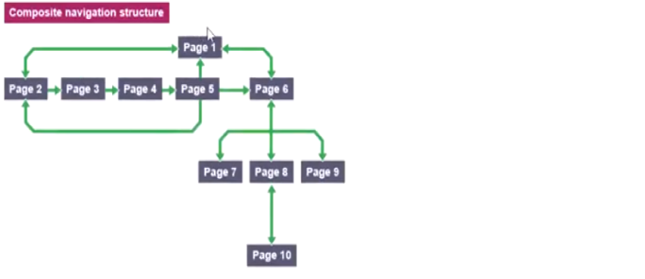
Composite Structure
Composite Structure = Linear Structure + Tree / Hierarchical Structure

Slide 15
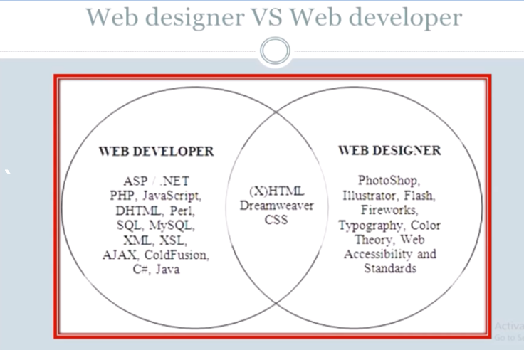

Slide 16
